Slide 1
Georgetown University · Applied AI in Business · Project 1
LendingClub Loan
Interest Rate Prediction
Comparing five model families and blending the two best tree-based models
100K
38
10K
RMSE
Training loans
Features (post-leakage)
Test loans
Competition metric
SAXA 5 · Andrew · Hannah · Jaci · Will · Lawrence
May 2026

Slide 2
OVERVIEW
Problem Statement & Dataset
Objective
100K
Predict the interest rate (int_rate) assigned to LendingClub loan applications using only information available at origination — before any post-funding outcome is known.
Training loans
10K
Business Value
Accurate rate prediction improves risk-based pricing, reduces adverse selection, and supports fairer, more consistent offers to borrowers — directly affecting lender profitability.
Test loans
6.5–31%
Key Constraint — Leakage
Target range
loan_status is a post-origination outcome and is dropped immediately on load. The classic grade / sub_grade / installment leakage trio is absent from this data slice.
12.95%
Mean rate

Slide 3
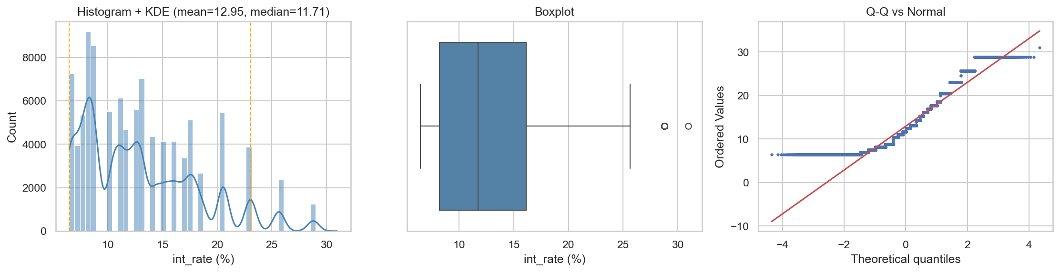
EDA · TARGET
Target Variable: Interest Rate Distribution
Shape
Modeling implication
Why it matters
Right-skewed (skew 0.85), long upper tail. Mean 12.95%, median 11.71%, range 6.46–30.99%.
No transform needed for tree models — boosted trees split on quantiles and handle the asymmetric target natively.
A spread of ~24 points means small RMSE gains are meaningful. Higher rates cluster in longer-term, higher-DTI loans.
Source: outputs/eda/02_target_distribution.png · true data/LC_train.csv (100,000 loans)

Slide 4
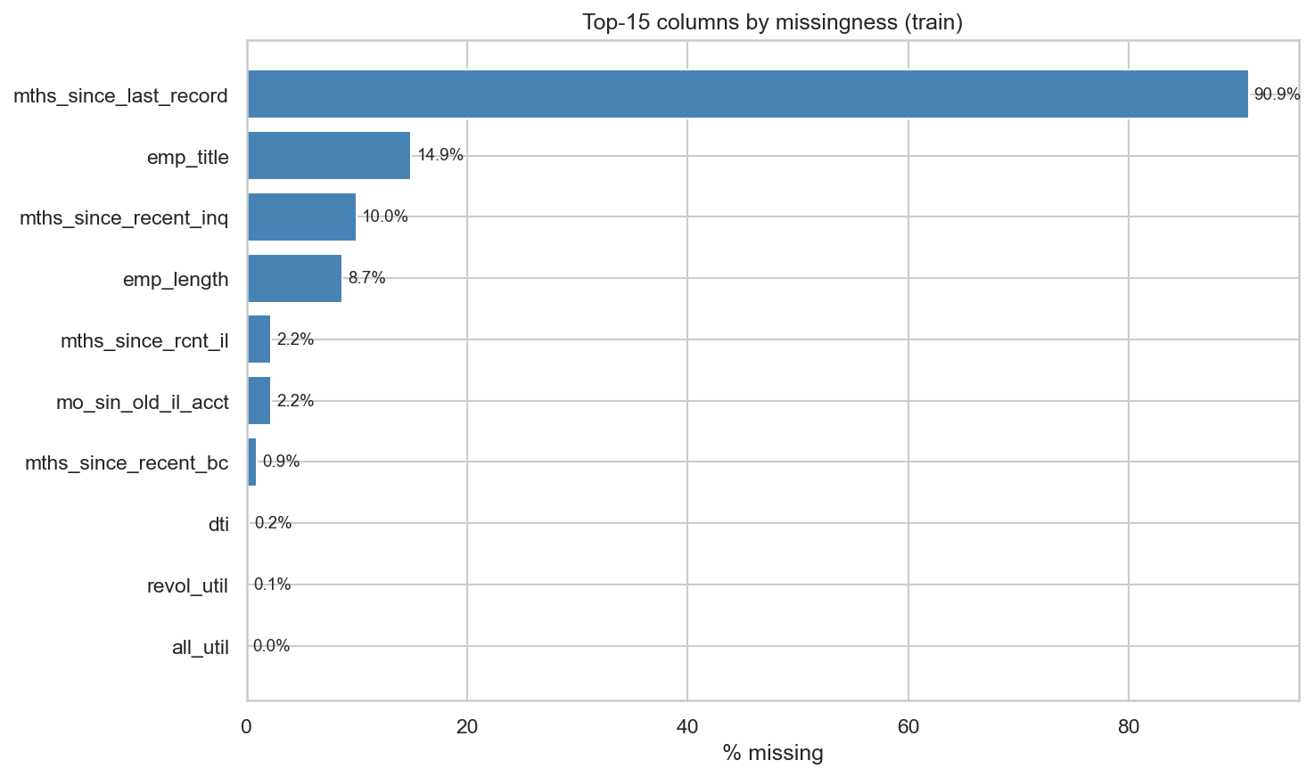
EDA · DATA QUALITY
Missingness Patterns
Only 10 columns have any missing data
Largest: mths_since_last_record at 90.9%, then emp_title (14.9%) and mths_since_recent_inq (10.0%).
Missing = informative
A blank “months since last record” means the borrower has no derogatory record at all. We add has_* flags instead of imputing a misleading number.
Co-missing pairs
mo_sin_old_il_acct and mths_since_rcnt_il are missing on the exact same 2,204 rows — same “no installment account” cause.
Source: outputs/eda/03_missingness_top15.png

Slide 5
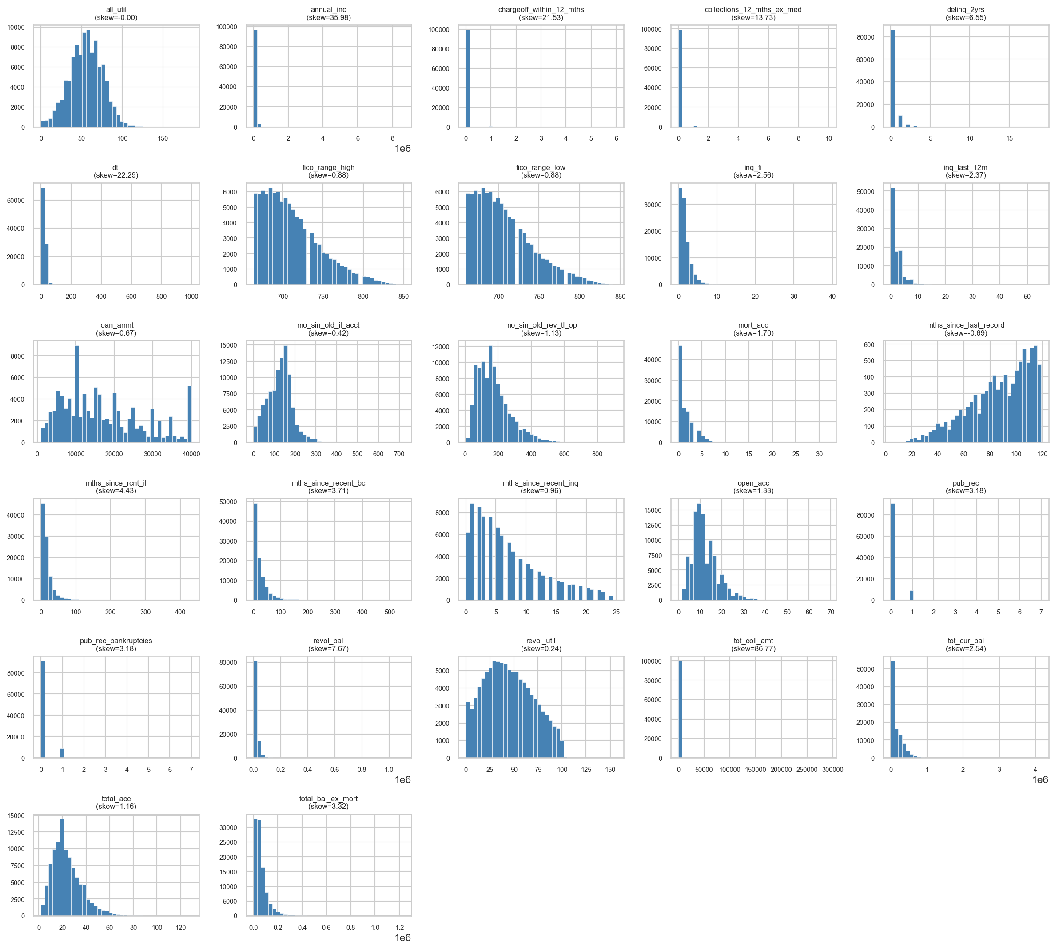
EDA · DISTRIBUTIONS
Feature Distributions & Outliers
Heavy-tailed monetary fields
annual_inc, revol_bal, tot_cur_bal, tot_coll_amt are highly right-skewed — log-transformed for stability.
Zero-inflated counters
tot_coll_amt is 88% zeros; pub_rec, delinq_2yrs are mostly zero — captured with binary “any event” flags.
Outliers kept, not deleted
Rare extremes (income > $1M, revol_util > 150%) are legitimate. Trees are robust to them; only linear models need winsorizing.
Source: outputs/eda/04_numeric_histograms.png

Slide 6
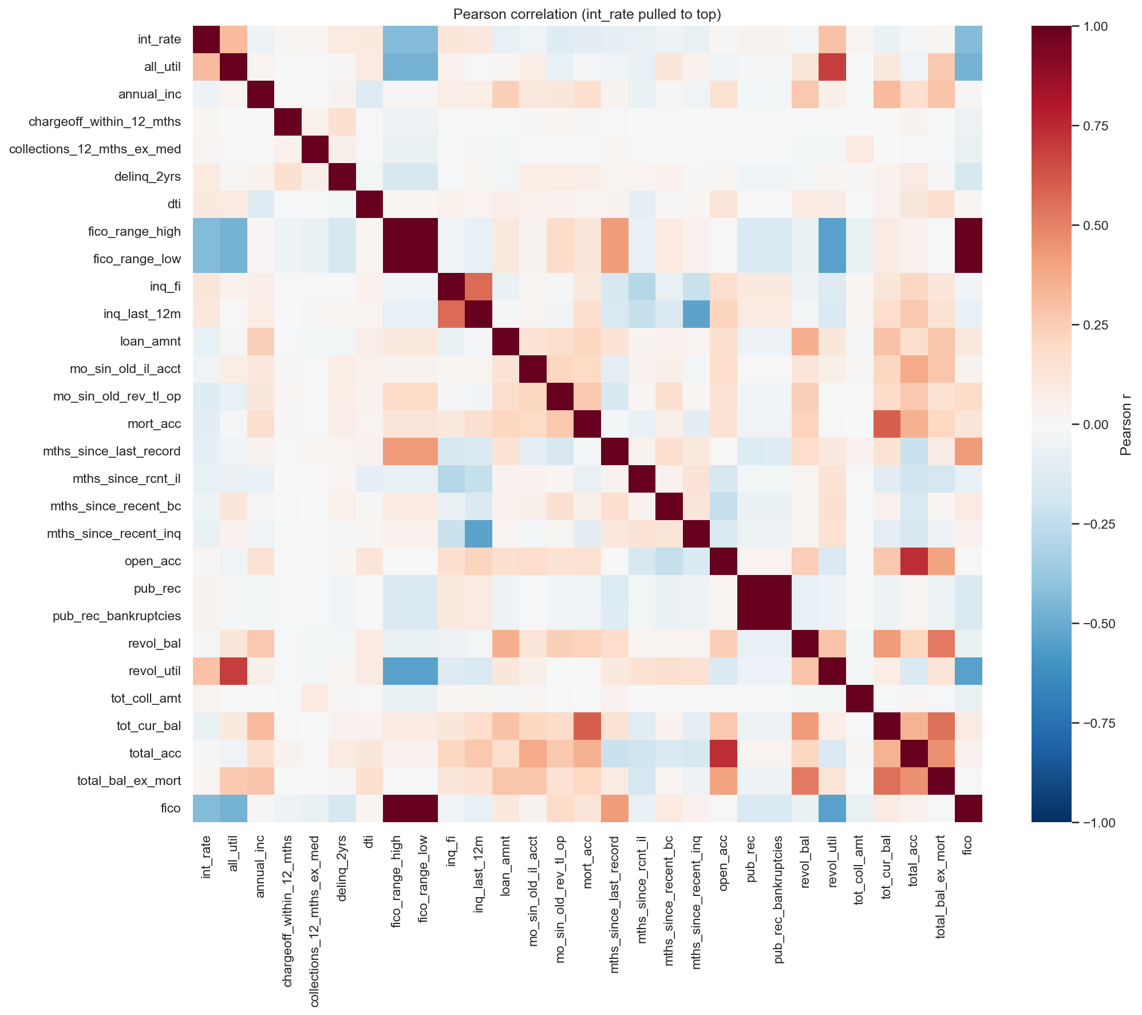
EDA · DRIVERS
Correlation, Multicollinearity & Top Drivers
Strongest signals vs. int_rate (Spearman)
FICO score
−0.46
all_util (utilization)
+0.33
revol_util
+0.30
dti
+0.18
loan term / purpose
categorical
Low multicollinearity
Only real redundancy is FICO low/high — collapsed to one midpoint. revol_util ↔ all_util (~0.75) overlap, which trees tolerate fine. Clean feature space.
Source: outputs/eda/07_correlation_heatmap.png · §5–7 EDA_REPORT.md

Slide 7
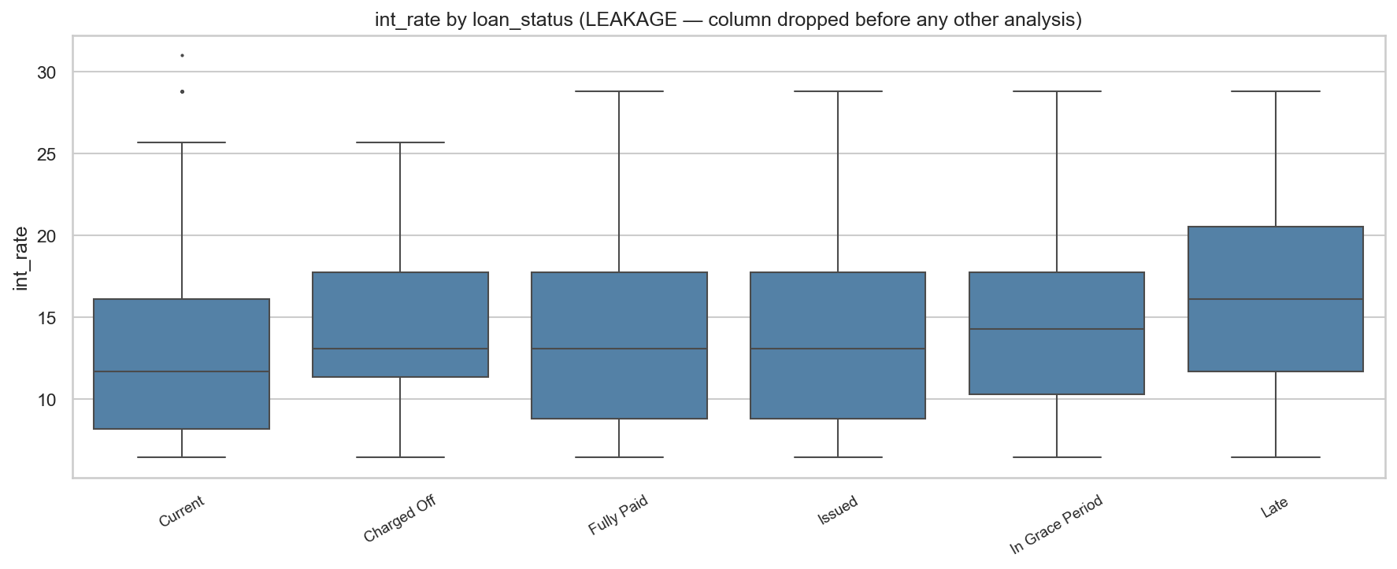
EDA · INTEGRITY
Leakage Checks & Train/Test Consistency
Leakage guard
loan_status dropped on load. All imputers, encoders and target-encoding fit on training folds only, then applied to validation/test — zero look-ahead.
Train vs. test drift
Test loans are smaller (loan_amnt −$3,039, PSI 0.17) and slightly higher-FICO (+5 pts). The test set is a more conservative sample — flagged for monitoring.
loan_status spreads rates by 3.4 pp — dropped before any EDA or modeling step.
Validation strategy
No date columns → random 5-fold CV (shuffle, seed 42), shared across models for fair comparison.
Source: outputs/eda/08_loan_status_leakage.png · §8, §10 EDA_REPORT.md

Slide 8
FEATURES
Why the Final Feature Set Makes Sense
Credit quality
Leverage & utilization
FICO midpoint (low+high)/2 — the single strongest, most intuitive driver of price.
revol_util, all_util, dti — how stretched the borrower already is.
Loan structure
Capacity
term (36/60 mo), loan_amnt, purpose — risk rises with longer, larger, riskier-purpose loans.
annual_inc (log), mort_acc, total_acc — ability to repay.
Behavioral flags
Dropped
has_derog_record, recent-inquiry flags — turn “missing” into real signal.
emp_title (35k free-text values), title (duplicate of purpose), and all leakage columns.
Every feature is knowable at loan origination — the test any candidate had to pass.

Slide 9
DATA PREP
Shared Preprocessing & Feature Engineering
Missing-value handling
Encoding & transforms
Validation strategy
• 8 numeric fields stored as text (dti, revol_util, all_util…) cast at load
• term → numeric months (36 / 60)
• No date columns → random 5-fold CV
• Literal “NA” strings read as null
• emp_length → ordinal (<1yr=0 … 10+=10)
• KFold(shuffle=True, random_state=42)
• Binary has_* flags for mths_since_* columns
• fico = average of fico_range low & high
• Same folds reused across all models
• Median imputation fit on train folds only
• log1p on skewed monetary fields
• Out-of-fold (OOF) predictions for fair, leak-free comparison
• emp_title / title dropped
Identical preprocessing substrate so every model family is compared on equal footing.

Slide 10
MODELING
Our Approach: A Five-Model Bake-Off
Each teammate independently built a different model family on the same data and folds. We then compared honestly and chose the best approach to ship.
Andrew — Boosted trees
Hannah — Bagged & boosted trees
XGBoost · CatBoost · LightGBM, tuned + blended
Random Forest, Extra Trees, Hist-Gradient-Boosting
Jaci — Single decision tree
Will — Neural network
Interpretable baseline, GridSearch-pruned
MLP regressor (deep-learning baseline)
Lawrence owned shared EDA, preprocessing and final integration. Winner selected on cross-validated RMSE.

Slide 11
COMPARISON
Model Comparison — Side by Side
Owner
Model
Validation
RMSE ↓
Note
Andrew
CatBoost ★
5-fold OOF (100k)
3.845
Best single model
Andrew
XGBoost
5-fold OOF (100k)
3.867
2nd best; corr 0.99 w/ CatBoost
Andrew
LightGBM
5-fold OOF (100k)
3.945
3rd tree; near-zero blend weight
Hannah
Random Forest
5-fold OOF (100k)
4.055
R² ≈ 0.41
Hannah
Hist-Grad-Boost
80/20 split (19.5k✱)
3.834✱
✱Smaller slice — not comparable
Jaci
Decision Tree
GridSearch (100k)
not saved
Metrics not recorded in notebook
Will
Neural Net (MLP)
5-fold OOF (100k)
5.101
One fold diverged (see next)
Team
CatBoost + XGBoost blend ★
Honest held-out (100k)
3.841
FINAL submission
RMSE in interest-rate points (lower is better). ★ selected for final blend. ✱Hannah's Hist-GB ran on a ~19.5k subset, so its score is not directly comparable to the 100k OOF results.

Slide 12
WHY NOT THE ANN
Neural Network: Unstable Training
Per-fold RMSE — one fold exploded
What went wrong
Fold 1
4.06
ok
On one fold the network's loss blew up (exploding-gradient-style instability): predictions diverged and R² went negative (−1.2). The aggregate metrics became unreliable and irreproducible.
Fold 2
4.11
ok
Fold 3
7.96
⚠ diverged
Fold 4
4.13
ok
Fold 5
4.02
ok
Why ANNs fit this data poorly
Mostly tabular, mixed-type, modest-size data with strong monotonic signals (FICO↓, utilization↑). Networks need heavy scaling/tuning to be stable here and still lagged the trees.
OOF RMSE 5.10 · R² 0.06 — dragged down by fold 3
Takeaway
Even the best stable NN (≈4.0 RMSE) trailed every boosted tree — so we moved to tree-based models.
Source: will/LC_Project1_Neural_Network_Model.ipynb (sklearn MLPRegressor, 5-fold OOF).

Slide 13
SELECTION
The Two Best Models Are Both Trees
After the bake-off, the two strongest, most reliable models were both gradient-boosted trees — evaluated on identical 100k out-of-fold predictions.
CatBoost ★ best single
XGBoost 2nd best
3.845
Handles categoricals natively; ordered boosting curbs overfitting. Strongest standalone score.
3.867
Optuna-tuned, deep history on this problem. Slightly different errors than CatBoost.
OOF RMSE
OOF RMSE
Tuned via grid search, 5-fold bagged refit, fully leakage-controlled.
LightGBM (3.945) was close behind but added no diversity, so it was set aside.
Both beat every non-tree model by a wide margin (NN 5.10, Ridge 4.12). Trees won on accuracy and stability — the natural fit for this tabular, mixed-type data.

Slide 14
FINAL MODEL
Why Blend the Two Best Trees
Lower variance
More stable & robust
Preserves performance
Averaging two strong models cancels out fold-to-fold noise. The honest held-out score (3.8414) almost exactly matched in-sample (3.8413) — an optimism gap of just 0.0001.
A weighted average can't swing as far as either model alone. We chose a simple constrained average over a meta-model (within 0.002) for transparency and defensibility.
The blend beats the best single model (CatBoost 3.8451 → 3.8414). Weights: CatBoost 0.72, XGBoost 0.27 — together ~99%; LightGBM rounded to near zero.
FINAL MODEL — CatBoost + XGBoost blend
3.841
0.72 / 0.27
+0.0001
SAXA5.csv
Held-out RMSE
Cat / XGB weight
Optimism gap
Submission
Why only a small gain? CatBoost and XGBoost errors correlate ~0.99 — blending two similar models caps the upside but buys real stability.

Slide 15
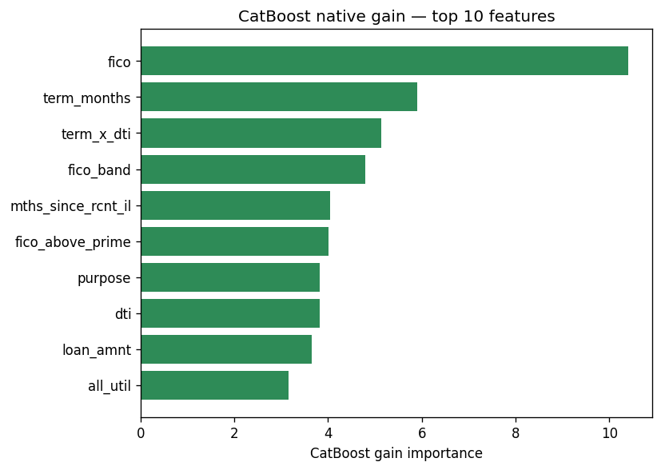
EXPLAINABILITY
What Drives the Prediction
Credit fundamentals lead
FICO score, utilization (revol_util / all_util) and DTI dominate — exactly the drivers a credit analyst would expect. Higher FICO → lower rate.
Confirmed two ways
SHAP and permutation importance agree on the ranking — the model relies on real risk signals, not data artifacts or leakage.
Explainable + leakage-safe → safe to trust for risk-based pricing.
Top-10 feature importance (gain) — final tree model
Source: outputs/simplification/ (SHAP & permutation importance on the final model).

Slide 16
CONCLUSION
Findings & Takeaways
Five model families compared on identical data and folds — boosted trees won decisively.
The neural network was unstable (one fold diverged, R² −1.2) and trailed every tree; rejected.
Final model blends the two best trees, CatBoost + XGBoost — RMSE 3.841, beating the best single model with a near-zero optimism gap.
FICO, utilization and DTI drive predictions; leakage (loan_status) removed before any analysis.
Best model: CatBoost + XGBoost blend · Held-out RMSE 3.841 · Submission: SAXA5.csv
Georgetown MSBA · Applied AI in Business · SAXA 5

Slide 17
APPENDIX
Model Details & Tuning
CatBoost (best single)
XGBoost
5-fold OOF RMSE 3.845. Native categorical handling, ordered boosting; grid-tuned, 5-fold bagged refit. emp_title OOF target-encoded (smoothed).
5-fold OOF RMSE 3.867. Optuna-tuned (depth, learning-rate, subsample). Frequency-encoded high-cardinality categoricals.
LightGBM
Hannah — RF / Extra Trees / Hist-GB
5-fold OOF RMSE 3.945. Coarse grid (108 combos). Negligible blend weight (0.013) — set aside.
RF OOF RMSE 4.055 (R² 0.41). Hist-GB 3.834 on a ~19.5k subset (not comparable to 100k OOF).
Jaci — Decision Tree
Will — Neural Net (MLP)
GridSearchCV over max_depth & ccp_alpha on 100k. Performance metrics were not saved in the notebook — flagged.
Baseline OOF RMSE 5.10 (fold 3 diverged). Best stable single-split ≈4.0. Tuned via RandomizedSearchCV.
All RMSE in interest-rate points. Blend = constrained weighted average (weights ≥0, sum 1), fit by leave-one-fold-out.

